Slide 1

Data
Restructuring
Todd Abraham
Iowa State University

Slide 2

What is Restructuring?
Changing Shape
New rows/columns
Changing Headers
New Variable Names (new row identifiers)
Changing Elements
New Values
Any Alteration of the Original Source Data
Document, Document, Document!

Slide 3
Why Restructure?
Data Quality
Inaccuracy and/or Redundancy
Usability
Missing Data – Points, Columns
Ease of Operations
Efficiency/Accuracy Tied to Structure
End-User Applications
How will the Data be Analyzed?

Slide 4
Data Structures
Single-Record Systems
1 Record & 1 Identifier Birth/Death Records
Longitudinal-Record Systems
Multiple Records & 1 Identifier Educational/Census Data
Multiple-Record Systems
Multiple Records & Multiple Identifiers Home Visits/Billing Records

Slide 5
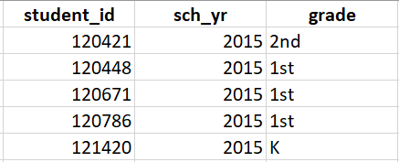
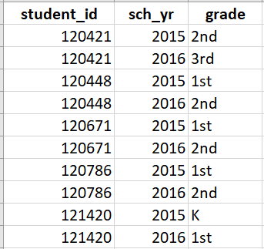
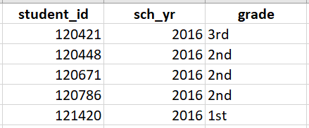
Restructured Structures
Aggregation – Combining Multiple Files Vertically
File 1
File 2
New File

Slide 6
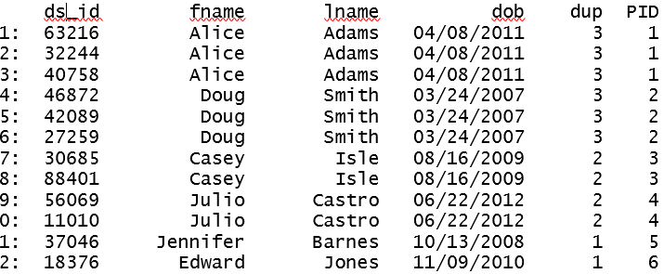
Restructured Structures
Joining (Merging) – Combining Multiple Files Horizontally
Unique Identifiers
Iowa’s 3 Counties: Obrien O’brien O’Brien
Within-Case New ID and Keys (family files)

Slide 7
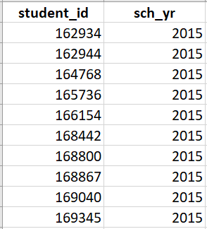
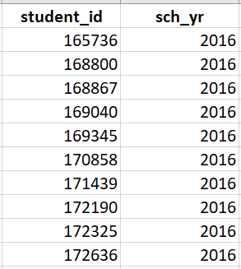
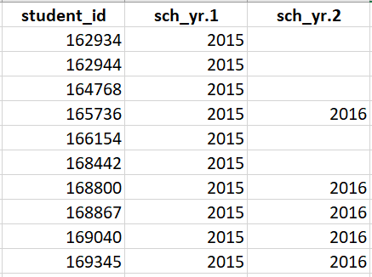
Joining (Merging) Data
Left Joining
File 1
File 2
Left Joined File
7

Slide 8
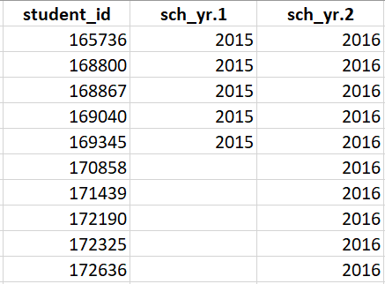
Joining (Merging) Data (cont.)
Right Joining
File 1
File 2
Right Joined File
8

Slide 9
Joining (Merging) Data (cont.)
Inner Joining
File 1
File 2
Inner Joined File
9

Slide 10
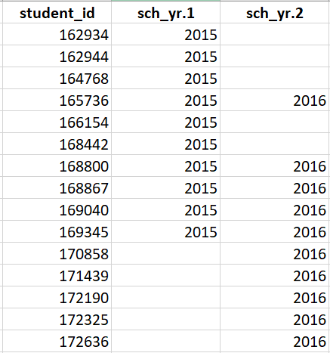
Joining (Merging) Data (cont.)
Full Joining
Full Joined File
File 1
File 2
10

Slide 11
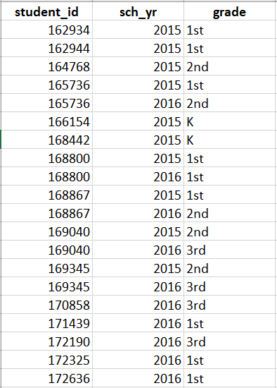
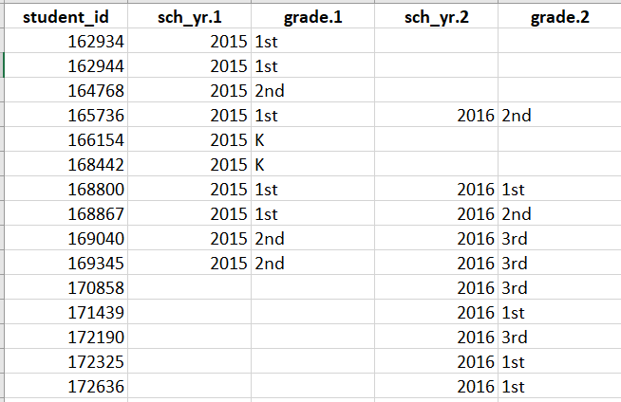
Stretching Files – “Long-to-Wide”
File 1
File 2

Slide 12
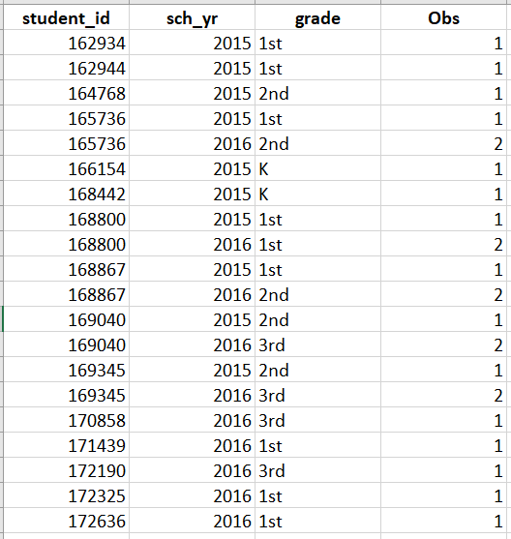
Stacking Files – “Wide-to-Long”
File 1
File 2

Slide 13
Restructuring by Transformation
Why Transform Data?
Data Management – Part of the Data Cleaning Process
Standardization – Consistency across Data System
Project Analytic Goals – What Data are Necessary
Common Transformations
Deletion vs. Filling – Missing Data
Recoding – Correction and Standardization
Indicator Creation – Analytic Use
Subsetting – Project Goals

